Slide 1






CREDIT CARD FRAUD DETECTION SYSTEM
Securing Transactions with Intelligence:
A Real-Time Credit Card Fraud Detection System

Slide 2

OVERVIEW
Abstract
Introduction
Motivation
Methodology
Survey
Data Description
Output
Conclusion

Slide 3


ABSTRACT
Out project uses machine learning (Decission Tree) to help detect fraud.
Finding fraud is tricky because:
Fraud cases are much rarer than normal transactions.
Fraud patterns keep changing, so the system must adapt.
Our project looks at ways to:
Handle the small number of fraud cases in the data.
Make sure the system can adjust to new fraud patterns.
Measure how well the system detects fraud.

Slide 4
INTRODUCTION
Credit card fraud is a serious issue, resulting in billions of dollars in losses each year. With the rise of online shopping and digital payments, fraud has become harder to detect. Fraud detection systems need to be fast and accurate, as fraud patterns constantly change and fraud cases are much rarer than regular transactions. Machine learning, a type of advanced computing, helps create smart systems that can identify unusual patterns in transactions, potentially indicating fraud. However, building these systems is challenging due to limited fraud data and the need for them to adapt as fraud tactics evolve. This project explores methods to improve fraud detection accuracy, helping protect both businesses and customers from financial loss.

Slide 5


MOTIVATION
Protect People’s Money:
Credit card fraud costs a lot of money loss, so it’s important to stop it.
Make Online Shopping Safer:
More people shop online, which means there’s a bigger chance for fraud. A good fraud detection system can make shopping safer.
Use Smart Technology:
Machine learning, a smart computer tool, can help find strange patterns that might mean fraud.
Learn from Patterns:
Fraud changes over time, so the system needs to keep learning and adjusting to new tricks.

Slide 6

METHODOLOGY
Data Collection:
Gather credit card transaction data with both fraud and non-fraud cases.
Data Preparation:
Clean data and select important details, like transaction amount and time.
Model Selection:
Test machine learning models Decision trees (0.938) & Random forests(0.999)

Slide 7

SURVEY
Machine Learning Models Used:
Logistic Regression (0.998)
Decision Trees (0.938)
Random Forest (0.999)
Random forests showed high accuracy in spotting fraud.
Past Research:
These models have been widely tested for fraud detection in various domains, particularly in credit card and online transactions.

Slide 8


DATA DESCRIPTION
Data includes transaction information, fraud labels, and features like location, amount, and time.
In data there are many columns labeled "V1," "V2," and so on, to "V28." These represent different characteristics or measurements about each transaction.
V1, V2, ..., V28: are columns are special measurements that come from complex mathematical calculations to make the data easier to understand and work with. They help in finding patterns related to normal or suspicious activities.

Slide 9
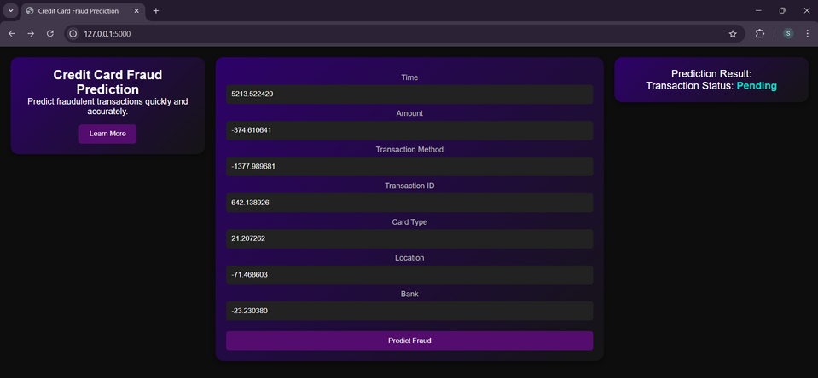
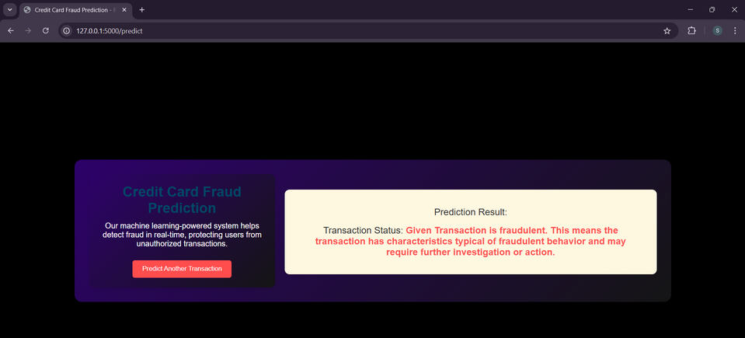
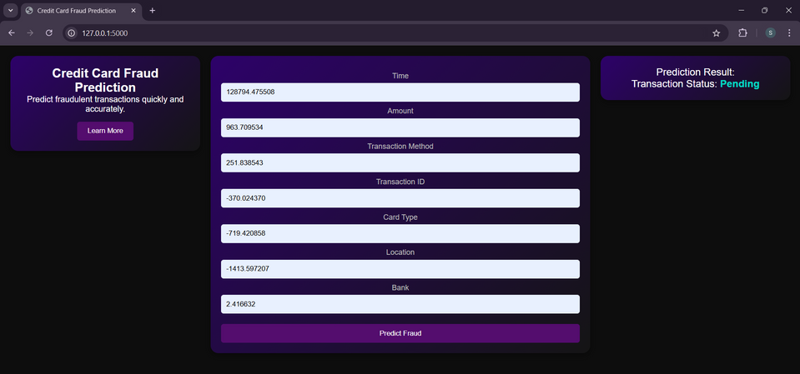
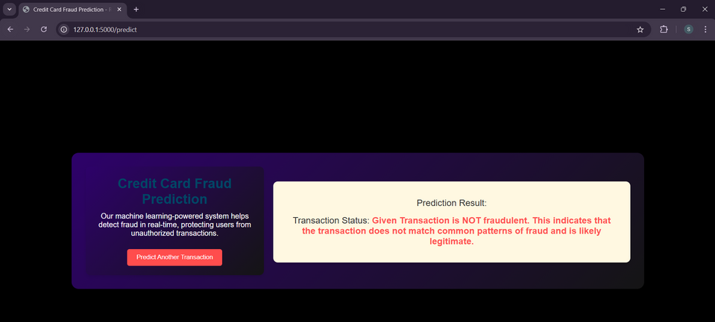
OUTPUT
Fraudulent Transaction
Not Fraudulent Transaction

Slide 10

CONCLUSION
This project made a smart computer system that can tell if someone is using a credit card in a sneaky or wrong way. It’s really good at knowing when someone is using their card normally and when something seems strange. It checks how people usually use their cards and can find problems fast without making mistakes that would annoy people. This helps banks and credit card companies save money and keeps everyone’s money safe.
What’s next:
To make the program even smarter, we can use even more advanced computer techniques. These new methods might help the program learn even better from the way credit card fraud changes over time.

Slide 11

Thank You
- Your name

